Slide 1
Procuring Accessible Information and Communication Technologies (ICT)
Developing an ICT accessibility procurement strategy. A presentation to CIPMM June 2023

Slide 2
Objectives
To demystify:
What needs to be considered in creating an ICT accessibility procurement strategy
The decisions that need to be made
Potential options and effects
To give you the confidence that your strategy is reasonable
Download the latest (GC only) tools developed for the pilot from the OPSA Accessibility Hub’s Procurement page (GCpedia).

Slide 3
Vision

Slide 4
The GC Vision
The Government of Canada (GC) envisions a public service that is a world leader in barrier-free, inclusive workplaces and services
Aiming to hire 5,000 people with disabilities by 2025
The Accessible Canada Act (ACA) and the Accessibility Strategy for the Public Service (ASPS) set the framework for achieving this vision – legislative requirements, goals, commitments and measurement
The consideration of accessibility in procurement is requirement, not a choice
All major systems launched, both internal and external, are to be accessible by 2040
For ICT, TBS has established a Guideline on Making Information and Technology Usable by All. The guideline strongly encourages federal organizations to “work with SSC and AAACT”

Slide 5
AAACT and supporting the GC vision
SSC’s Accessibility, Accommodation and Adaptive Computer Technology (AAACT) program
Accommodations including adaptive technology
Mostly individual services related to disability or injury
Accessibility and inclusive design
Conformance testing, training, consultation…
Disability inclusion + Accessibility + + Adaptations + Accommodations
= Perspective

Slide 6
Procurement can improve accessibility
Shared Services Canada is the common service provider for ICT for the Government of Canada enterprise-wide
Provides digital services to GC departments that are used by employees to do their jobs and serve Canadians
The buying power of the GC is significant. In FY2021-22 SSC alone:
Awarded more than 7,300 contracts
Totalling $2.52 billion – mostly ICT
Accessibility requirements in GC procurements can financially and competitively incentivise companies to make their products and services accessible
Eventually, everything is built accessible by default

Slide 7
ICT accessibility standards

Slide 8
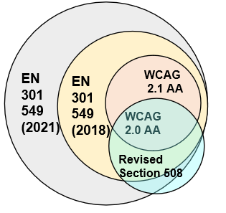
Accessibility standards compared
Web Content Accessibility Guidelines (WCAG)
WCAG 2.1 (2018) adds criteria to WCAG 2.0 (2008)
Criteria divided into A, AA and AAA levels
Revised Section 508
US standard since 1998
2017 revision includes WCAG 2.0 levels A and AA
Also includes hardware, software requirements
EN 301 549
European standard since 2014
Closely harmonized with Revised Section 508
Includes WCAG 2.1 levels A and AA since 2018 (SSC is piloting)
Since 2021, includes WCAG 2.1 levels A, AA and AAA (TBS expected to implement the EN 301 579 (2021))
* not to scale

Slide 9
Differences between EN 301 549 and WCAG
The EN 301 549 is the Harmonized European Standard of Accessibility requirements for ICT products and services
It includes:
WCAG 2.1 for web, software and documents
additional requirements for hardware, authoring tools, support services and more
WCAG is only for web, and does not sufficiently cover the full range of ICT accessibility
Ongoing technology advancements requires us to use a broader standard

Slide 10
SSC roles and responsibilities

Slide 11
Role of the Accessibility Triage Team ATT / AAACT procurement team
Upon request, consulting with SSC Technical and Contracting Authorities (TA/CAs) during the procurement process (all phases)
Building tools to support TA/CAs
Facilitating communications, research and collaboration
Training for Technical and Contracting Authorities
Sharing our approach with other GC departments and industry groups upon request
Including meetings with USA (US Access Board, General Services Administration and NASA), European Commission, Australia (Federal Government, South & West Australia, Queensland), Belgium, Netherlands, Ontario, British Columbia

Slide 12
Role of SSC Technical Authority (TA) (1 of 2)
Develop the ICT accessibility procurement strategy; the ICT accessibility requirements and evaluation based on the EN 301 549 accessibility standard
Assistance from ATT / AAACT is available
If you want AAACT to participate in the evaluation (accessibility conformance testing, evaluating ACRs) you must meet with the AAACT Manager to pre-arrange this prior to issuing your procurement
…continued

Slide 13
Role of SSC Technical Authority (TA) (slide 2 of 2)
Secure TA Director General’s approval when appropriate
ensure that the solution meets the ICT accessibility requirements at contract award or by # months as specified in the contract
support the Contracting Authority (CA) completing the Procurement Summary and Risk Assessment (PSRA) form and obtaining governance review and endorsement, as required
ICT Enterprise solutions: work with the ATT at the requirements gathering stage if possible
ICT Non-enterprise solutions: work with AAACT (as desired) at the requirements gathering stage if possible

Slide 14
Role of SSC Contracting Authority (CA)
Ensure the TA has considered accessibility in the Statement of Work or Statement of Requirements (SoW / SoR)
Ask TA questions; raise concerns with the ATT or AAACT as appropriate
Consult with ATT / AAACT for supplier questions / industry days / supplier conferences
Ensure documentation of any accessibility decisions are on the procurement and contract file
Responsible for the inclusion of the appropriate accessibility language in both the solicitation and contractual documents when applicable
Seek legal review for the accessibility approach and clauses
With the TA, obtain governance review and endorsement, as required

Slide 15
Let’s talk about your ICT accessibility procurement strategy

Slide 16
Create your ICT accessibility strategy
Determine which elements of your purchase need to have ICT accessibility
Decide how the supplier will confirm their conformance
Create your evaluation criteria and identify who will evaluate the ICT accessibility requirements
Insert the appropriate accessibility language
Seek assistance from either the ATT or AAACT

Slide 17
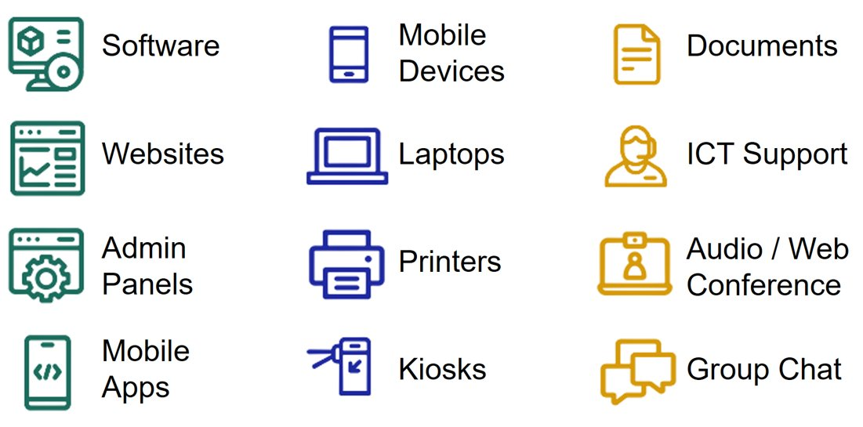
Determine which elements of your purchase need to have ICT accessibility requirements
Is it ICT? Are GC employees interacting with it directly?
If yes, ICT accessibility requirements likely apply
Examples of ICT

Slide 18
Decide how suppliers will demonstrate their conformance (1 of 5)
There are some decisions that need to be made at the beginning of your planning process
Determine the implementation plan:
In phases, with increasing conformance?
“Big bang” launch, requiring conformance to the accessibility standards at launch?
Decide when the solution needs to be fully conformant (or as conformant as possible?
At Contract Award?
Within x number of months after Contract Award?
At implementation?
…continued

Slide 19
Decide how suppliers will demonstrate their conformance (2 of 5)
Decide how often the successful bidder must reassess their solution against the accessibility standard
At a minimum, after major software updates?
Annually or at certain project milestones?
If a preliminary procurement stage of multiple stages
Include several questions in your first stage to gauge market maturity
Let bidders know that:
The ICT accessibility requirements will progress as the solicitation progresses
That the successful bidder will be required to conform to the EN 301 549
Provide Annex X (the accessibility requirements from the EN 301 549 generated by the ICT requirements wizard, which was developed as part of SSC’s pilot)

Slide 20
Decide how suppliers will demonstrate their conformance (3 of 5)
Ensure that all phases of your procurement has ICT accessibility language, and that the language is incorporated into your resulting Contract.
Recommended that in the solicitation that bidders confirm that they have read the ICT accessibility requirements (EN 301 549), and provide an attestation or certification that:
The bidder’s solution already meets the requirements* OR
Their solution will be brought up to conformance within x-number months of contract award (or whatever timeline the TA states is appropriate)*
If successful, the bidders also agree to provide a detailed Roadmap which illustrates how the solution will be brought up to conformance
Ask suppliers to submit an Accessibility Conformance Report (ACR) based on the Voluntary Product Accessibility Template (VPAT®) to prove their attestation
…continued

Slide 21
Decide how suppliers will demonstrate their conformance (4 of 5)
Require the supplier to provide an ACR based on Voluntary Product Accessibility Template (VPAT®) (Choose the right VPAT template - prefer EU or INT)
ACRs should be:
preferably prepared by a third-party prepared ACR using the VPAT® vs. an ACR completed by the supplier’s qualified in-house accessibility specialist
tested against the EN 301 549 and be for the whole solution you are purchasing (not just part of it)
preferably be no more than 12 months old, but up to 24 months old is acceptable as long as it represents what you are buying
Decide if you will make the submission of an ACR:
mandatory (recommended)
optional
…continued

Slide 22
Decide how suppliers will demonstrate their conformance (5 of 5)
More information on the roadmap:
If the successful supplier does not presently conform with the accessibility requirements, then the supplier must provide a remediation plan (roadmap). This plan will detail how they will fully meet the requirements within [#] months of contract award, including:
timelines to remediate accessibility issues the evaluation team identifies
timelines to remediate accessibility issues end users identified
software upgrade options that would resolve accessibility issues
plans to subcontract accessibility audits and remediation
plans and ability to internally audit and remediate accessibility

Slide 23
Create evaluation criteria and identify who will evaluate the ICT accessibility requirements (1 of 2)
Decide what you will do with the ACR and if you will:
review the ACR and assign a score and make it part of the evaluation criteria to select the successful bidder (recommended)
review the ACR for information only and not assign a score
…continued

Slide 24
Create evaluation criteria and identify who will evaluate the ICT accessibility requirements (2 of 2)
Decide how you will evaluate the accessibility of the solution(s)
Annex Y – contains the testable elements of those ICT components selected in Annex X (both produced from ICT requirements generator)
Will you (or the departmental digital group) do accessibility conformance testing against the EN 301 549?
Will you hire a third party accessibility conformance tester to verify the supplier’s claims?
Will you try to engage AAACT to do Litmus testing (small sample of pages reviewed)?
How will you approach user testing with people with disabilities?

Slide 25
Insert the appropriate accessibility language
Review the appropriate draft accessibility language and:
Use verbatim or edit to suit your needs
Use it to inspire you
Adapt the accessibility language used in the solicitation for the Contract
include Annex X (the ICT accessibility requirements from the EN 301 549) as part of the Contract so there is a clear record of what the supplier is required to deliver
ensure information about the frequency of accessibility conformance testing, user testing, submission of updated ACRs and Roadmaps, etc. is specified
get legal services review of the accessibility language

Slide 26
Ensuring the successful supplier provides an accessible solution (1 of 2)
Supplier is responsible for the conformance of their solution to the EN 301 549
In very general terms, the following is the recommended approach for mitigating risk or addressing a product that isn’t fully accessible:
Raise the accessibility issue(s) with the supplier
Review the Roadmap to full conformance with the supplier and ensure it has reported timelines
Schedule regular review periods for that timeline
After the above, transparently communicate barriers and workarounds up front to the stakeholders / clients / employees / participants and brief senior management
…continued

Slide 27
Ensuring the successful supplier provides an accessible solution (2 of 2)
Clearly identify the alternative approach and properly resource it to ensure everyone can participate with the same timelines and an equitable experience E.g. maybe there’s a workaround or a staff member who will support requests
Schedule regular follow-ups with the company and the project
Ensure that this product is not marketed within the department as an accessible solution
Brief senior management (TA’s Director General) and get the signoff on approach
Refer to the SSC developed tools and/or contact AAACT or your legal counsel for further assistance

Slide 28
Conclusion

Slide 29
Seek assistance from either the ATT or AAACT
Seek assistance as early as possible in the development of your requirements from either the:
ATT (SSC enterprise procurements that will impact more than 1 government department) or
AAACT (SSC non-enterprise procurements and Other Government Department and Agency (OGD) procurements and sole source contracts)
Use the tools that have been developed as part of our pilot of the EN 301 549

Slide 30
Consider taking other related training (GC staff only)
Check GCPedia for a list of AAACT training opportunities (changes monthly)
GC Accessibility Training and Events / Formation et événements du GC sur l'accessibilité - GCpedia
Procuring Accessible Information and Communication Technologies (ICT) – SSC Strategy and Pilot Implementation Presentation
An overview highlighting the full lifecycle from creating your accessibility strategy, more details regarding evaluation through to implementation
Accessibility Conformance Reports and Accessibility Roadmaps (under development)
A detailed exploration of understanding how to use ACRs and Roadmaps

Slide 31
Contacts (GC only)
SSC - Enterprise procurements:
ATT / ETA (SSC/SPC) att-eta@ssc-spc.gc.ca
SSC non-enterprise or OGD procurements:
AAACT / AATIA (SSC/SPC) aaact-aatia@ssc-spc.gc.ca
AAACT (sample # pages / usability) testing:
AAACT / AATIA (SSC/SPC) aaact-aatia@ssc-spc.gc.ca

